Slide 1
SUPPLY CHAIN ANALYSIS A Complete Diagnostic & Comparison Report
Name:: SAMIULLA NADAF
Batch id:: [19-JAN-26-CDA-BUN-040-WDM1130-BAN]
Team id:: [PTID-CDA-MAY-26-11163]

Slide 2
Project Objective
Analyse supply chain data across 23 attributes including products, suppliers, logistics and quality
Build an interactive Power BI dashboard comparing supply chain performance for different product types
Identify top-performing and underperforming suppliers using defect rates and lead times
Evaluate logistics efficiency across shipping carriers, routes and transport modes
Track stock levels, production volumes and availability by product type
Enable data-driven decision making for supply chain optimization

Slide 3
Tools & Techniques Used
Tools: Power BI Desktop | Power Query Editor | SQL Database | Microsoft PowerPoint Data Cleaning: Set correct data types for all 23 columns | Renamed Lead time columns (Customer vs Supplier) | Trimmed text columns | Added Stock Status calculated column | Added Profit Margin % column DAX Measures: Total Revenue | Total Units Sold | Avg Defect Rate | Pass Rate % | Revenue per Unit | Avg Stock Level | Avg Lead Time | Avg Price | Total Mfg Cost | Total Transport Cost Visualizations: KPI Cards, Bar, Column, Line, Scatter, Donut, Pie, Map, Table | 5 Synced Slicers | Conditional Formatting | Traffic Light Colors

Slide 4
Dashboards: SUPPLY CHAIN Analysis
Page 1 — Executive Overview: 6 KPI Cards | Revenue by Product Type | Sales by Demographics | Revenue by Supplier Location (Map) | Order Quantity by Product Type | Avg Availability by Product Type | 3 Slicers Page 2 — Operations & Logistics: Stock Level vs Lead Time | Shipping Cost by Carrier | Revenue vs Transport Cost | Revenue by Route | Stock Status Count | Shipping Times | Production Volume | 4 Slicers Page 3 — Quality & Suppliers: Defect Rate vs Mfg Cost (Scatter) | Inspection Results (Pie) | Supplier Performance Table | Mfg Lead Time by Supplier | 4 Slicers

Slide 5
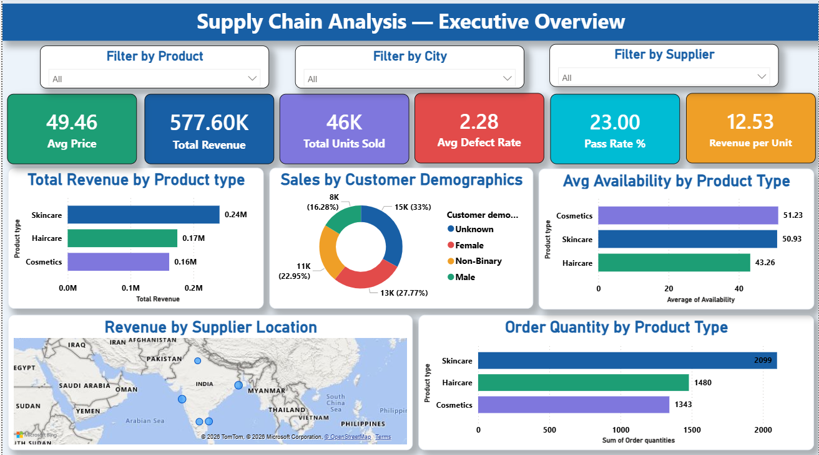
PAGE 1 EXECUTIVE OVERVIEW
📊 6 KPI Cards — Revenue ₹577.60K, Units 46K, Defect Rate 2.28%
🛍️ Skincare leads revenue at ₹242K — highest product
👥 Unknown demographic is largest customer segment (33%)
🗺️ Suppliers spread across 5 Indian cities
📦 Skincare has highest order quantity — 2,099 units
🟢 Cosmetics has best availability at 51.23

Slide 6
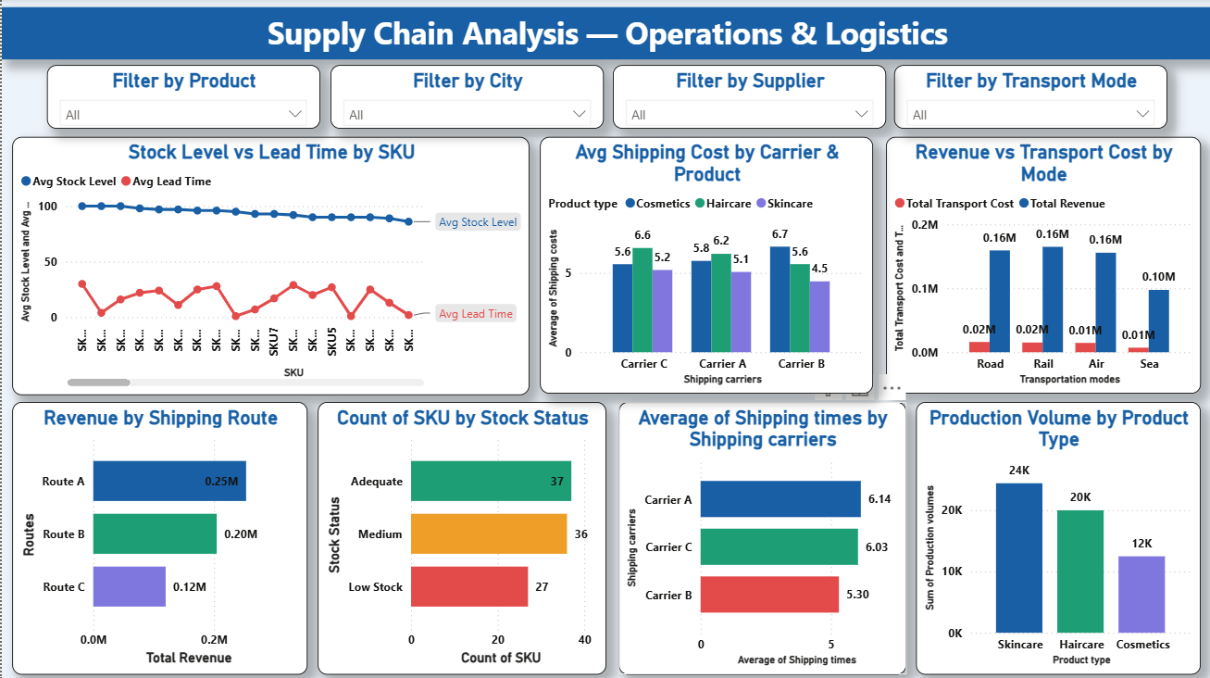
Page 2 OPERATIONS & LOGISTICS
📉 Stock levels healthy (55-100) but Lead Time highly variable (0-30 days)
🚚 Carrier B is cheapest (4.5) AND fastest (5.30 days) — best carrier
🛣️ Route A most profitable at ₹0.25M
🔴 27 SKUs at Low Stock — immediate reorder needed
🚂 Rail generates highest revenue ₹165K — most efficient transport
🏭 Skincare has highest production volume at 24K units

Slide 7
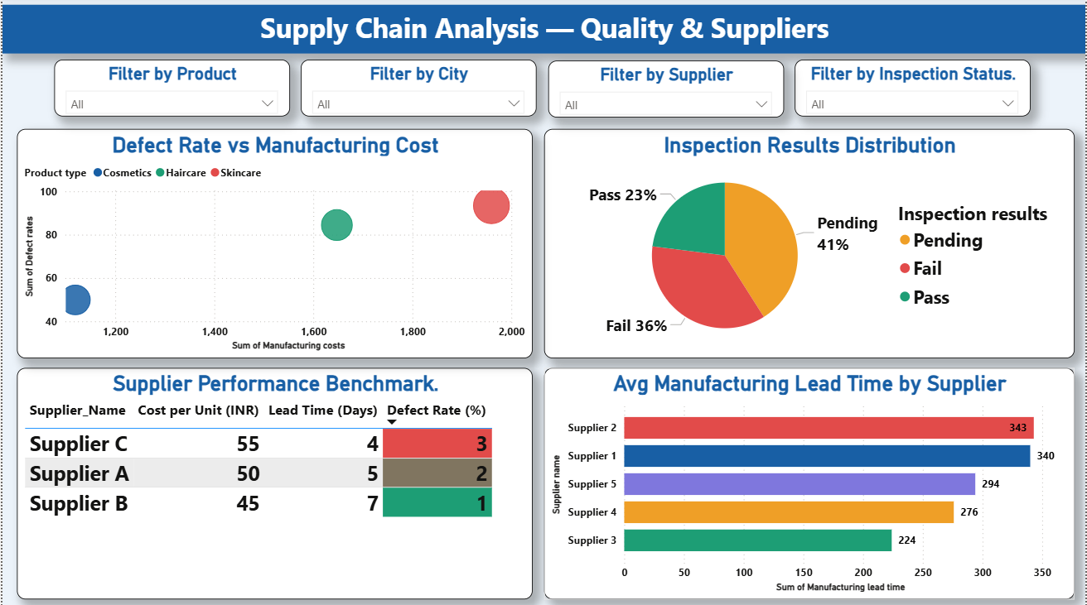
PAGE 3 QUALITY & SUPPLIERS
⚠️ Only 23% items Pass inspection — critical quality issue
🔴 36% items Fail and 41% Pending — major QC backlog
✅ Supplier B best — lowest cost ₹45 and defect rate 1%
❌ Supplier C worst — highest cost ₹55 and defect rate 3%
📊 Skincare highest defect rate AND manufacturing cost — double risk
⏱️ Supplier 2 slowest lead time at 343 days — supply chain bottleneck

Slide 8
Key kpi From dashboard
KEY KPIs FROM DASHBOARD
Total Revenue: ₹577.60K — overall supply chain revenue
Total Units Sold: 46K across all product types
Avg Defect Rate: 2.28% — quality benchmark
Pass Rate %: 23% — only 23 out of 100 items pass QC
Avg Price: ₹49.46 per unit
Revenue per Unit: ₹12.53 — efficiency metric

Slide 9


SLICERS (INTERACTIVE FILTERS)
Filter by Product — filter all visuals by Skincare, Haircare or Cosmetics — synced across all 3 pages
Filter by City — filter by Mumbai, Delhi, Kolkata, Chennai, Bangalore — synced across all 3 pages
Filter by Supplier — filter by Supplier 1 to 5 — synced across all 3 pages
Filter by Transport Mode — Page 2 only — filter by Air, Road, Rail, Sea
Filter by Inspection Status — Page 3 only — filter by Pass, Fail, Pending
All 3 global slicers are synced — selecting one filter updates all 3 pages simultaneously!

Slide 10
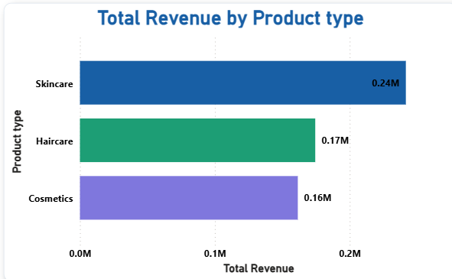
TOTAL REVENUE BY PRODUCT TYPE
Skincare leads revenue at ₹242K — highest among all product types
Haircare generates ₹174K — strong second position
Cosmetics contributes ₹162K — close competition with Haircare
Skincare accounts for 42% of total revenue — primary revenue driver
Total revenue across all products: ₹577.60K
Focus marketing and production efforts on Skincare for maximum ROI

Slide 11
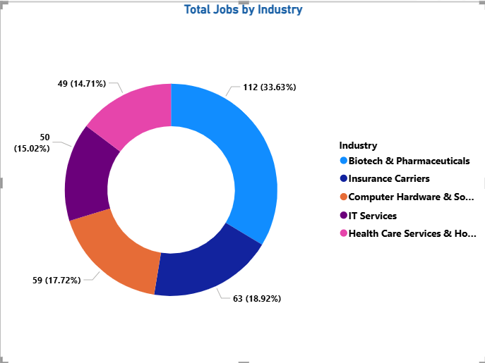
SALES BY CUSTOMER DEMOGRAPHICS
Unknown demographic is the largest segment at 33% — customer data profiling needed
Male customers account for 27.77% — second largest buying segment
Non-Binary customers contribute 22.95% — significant segment
Female customers are 16.28% — lowest segment surprisingly
Implement CRM tracking to convert Unknown to known demographics
Target Male and Unknown segments for highest marketing impact

Slide 12
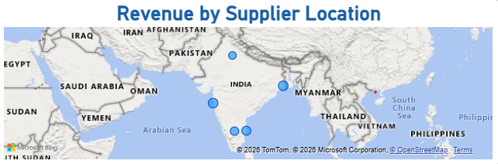
REVENUE BY SUPPLIER LOCATION
Suppliers spread across 5 major Indian cities — Mumbai, Delhi, Kolkata, Chennai, Bangalore
Bubble size represents revenue — larger bubble means higher revenue from that location
Geographic diversification reduces single point supply chain failure risk
Mumbai and Southern cities show strong revenue contribution
Location-based filtering available through the City slicer
Expanding supplier network in high-revenue cities can boost performance

Slide 13
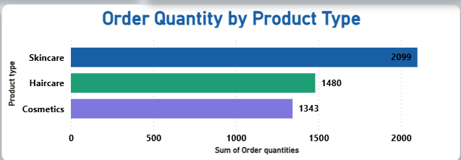
ORDER QUANTITY BY PRODUCT TYPE
Skincare has highest order quantity at 2,099 units — strongest market demand
Haircare follows with 1,480 orders — consistent demand
Cosmetics has lowest orders at 1,343 — needs demand generation
Total orders across all products: 4,922 units
Order volume aligns with revenue — Skincare dominates both
Increase production capacity for Skincare to meet demand

Slide 14
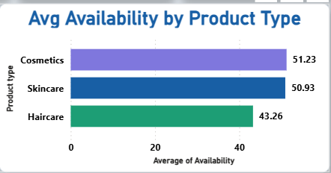
AVG AVAILABILITY BY PRODUCT TYPE
Cosmetics has highest availability at 51.23 — best stocked product
Skincare availability is 50.93 — adequate but demand is very high
Haircare has lowest availability at 43.26 — highest stockout risk
Haircare is at risk despite having 1,480 orders — restock urgently
Availability and order quantity must be balanced for each product
Monitor Haircare stock levels weekly to prevent supply gaps

Slide 15
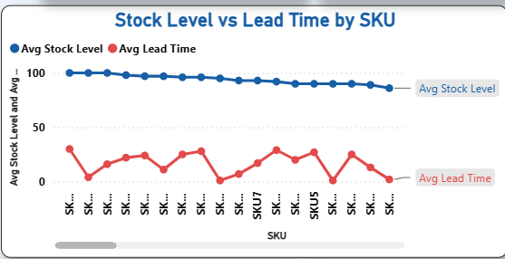
STOCK LEVEL VS LEAD TIME BY SKU
Red line (Avg Lead Time) zigzags between 0-30 days — high variability
SKUs with high lead time and low stock are highest stockout risk
Stock levels gradually decrease across SKUs — restocking needed
Lead time fluctuations indicate supplier inconsistency
Blue line (Avg Stock Level) sits between 55-100 — generally healthy stock levels
Monitor SKUs where red line spikes and blue line dips simultaneously

Slide 16
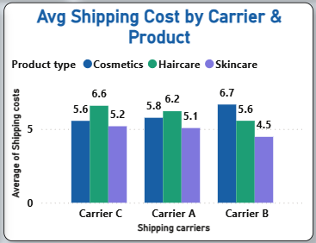
AVG SHIPPING COST BY CARRIER & PRODUCT
Carrier B has lowest avg shipping cost at 4.5 — most cost efficient carrier
Carrier C has highest cost at 6.6 — most expensive for Haircare
Skincare has highest shipping cost across all carriers
Cosmetics is cheapest to ship across all carriers
Recommend shifting Skincare shipments to Carrier B for cost saving
Carrier selection significantly impacts total logistics cost

Slide 17
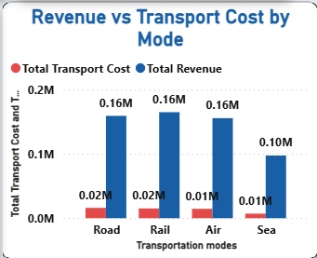
REVENUE VS TRANSPORT COST BY MODE
Rail generates highest revenue at ₹165K — most profitable transport mode
Road follows closely at ₹159K — consistent revenue performer
Air and Rail both generate ₹156K and ₹165K — strong performers
Sea has lowest revenue at ₹98K — least efficient mode
Transport costs are only ₹7K-₹16K vs revenue — excellent margin
Recommend expanding Rail and Road shipments for maximum ROI

Slide 18
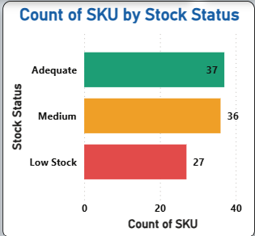
COUNT OF SKU BY STOCK STATUS
37 SKUs are at Adequate stock level — 37% of products are well stocked
36 SKUs at Medium level — 36% need monitoring and restocking soon
27 SKUs at Low Stock — 27% are at immediate risk of stockout!
Red Low Stock SKUs need urgent reorder to prevent revenue loss
Traffic light system enables instant stock health identification
Implement automated reorder alerts for all Low Stock SKUs immediately

Slide 19
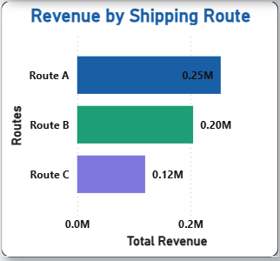
REVENUE BY SHIPPING ROUTE
Route A is the most profitable route generating ₹0.25M revenue
Route B follows at ₹0.20M — strong consistent performer
Route C generates only ₹0.12M — lowest revenue route
Route A generates 43% of total shipping revenue
Prioritize high-value shipments through Route A
Review Route C cost-effectiveness — consider switching to Route A or B

Slide 20
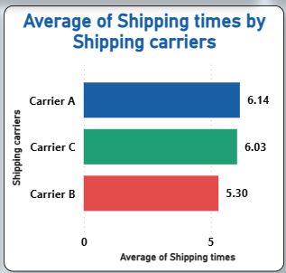
AVG SHIPPING TIMES BY CARRIER
Carrier B is fastest with avg shipping time of 5.30 days — best for urgent orders
Carrier C follows at 6.03 days — moderate speed
Carrier A is slowest at 6.14 days despite being most used
Speed difference between Carrier B and A is nearly 1 full day
Combine cost analysis: Carrier B is BOTH cheapest AND fastest — clear winner
Recommend switching majority of shipments to Carrier B

Slide 21
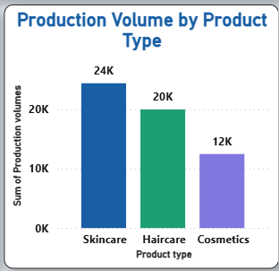
PRODUCTION VOLUME BY PRODUCT TYPE
Skincare has highest production volume at 24K units — matches market demand
Haircare produces 20K units — adequate production for demand level
Cosmetics has lowest production at 12K units — significant gap vs others
Production volumes align with revenue — Skincare leads both
Cosmetics gap between production and availability needs investigation
Consider increasing Cosmetics production to capture more market share

Slide 22
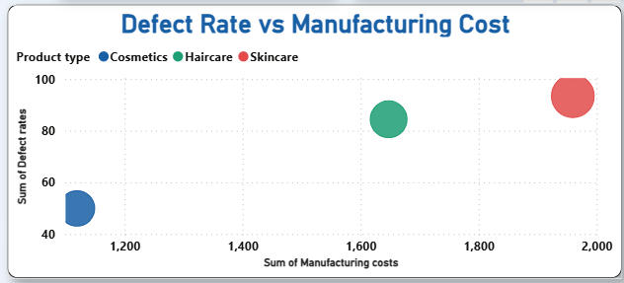
DEFECT RATE VS MANUFACTURING COST
Skincare (red dot) has HIGHEST manufacturing cost (~₹2000) AND highest defect rate (~93) — double risk!
Haircare (green dot) has medium cost (~₹1600) and medium defect rate (~84)
Cosmetics (blue dot) has LOWEST cost (~₹1100) and lowest defect rate (~50) — best quality
Higher manufacturing cost does NOT guarantee lower defects — Skincare proves this
Skincare manufacturing process needs immediate quality review
Cosmetics production process is the most cost-efficient and highest quality model to replicate

Slide 23
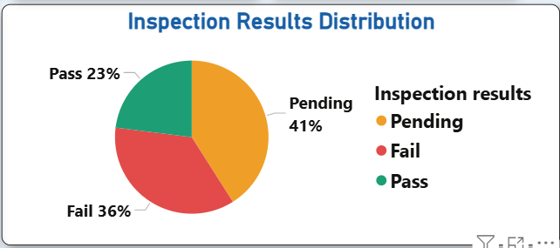
INSPECTION RESULTS DISTRIBUTION
Only 23% of items PASS inspection — critically low pass rate across all products
36% of items FAIL inspection — more than 1 in 3 items are defective
41% of items are PENDING inspection — massive QC backlog causing supply delays
Total failure + pending = 77% of items are NOT ready for delivery
QC bottleneck is the biggest risk to supply chain performance
Implement automated inspection process to clear the 41% pending backlog urgently

Slide 24
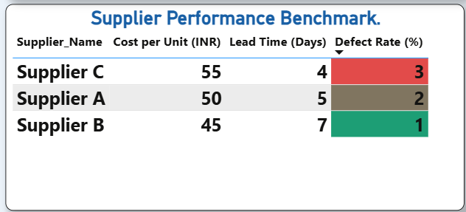
SUPPLIER PERFORMANCE BENCHMARK
Supplier B is BEST — lowest cost ₹45/unit, 7 days lead time, only 1% defect rate (GREEN)
Supplier A is MIDDLE — ₹50/unit, 5 days, 2% defect rate (AMBER)
Supplier C is WORST — highest cost ₹55/unit, only 4 days but 3% defect rate (RED)
Conditional formatting instantly shows supplier quality at a glance
Increase procurement volume from Supplier B — best value and quality
Review and renegotiate Supplier C contract — not justifying higher cost

Slide 25
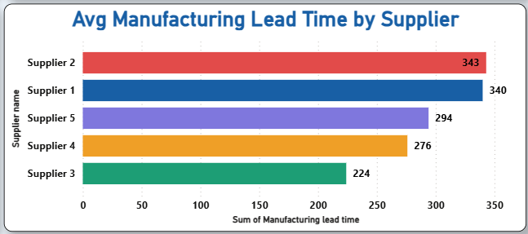
AVG MANUFACTURING LEAD TIME BY SUPPLIER
Supplier 2 has longest manufacturing lead time at 343 days — biggest bottleneck!
Supplier 1 close behind at 340 days — both need urgent timeline negotiation
Supplier 3 is fastest at 224 days — 119 days faster than Supplier 2
Gap between fastest (224) and slowest (343) is 119 days — massive difference
Long lead times directly cause stock shortages and delayed deliveries
Negotiate stricter SLAs with Supplier 1 and 2 to reduce lead times below 250 days

Slide 26
CONCLUSION
Skincare leads revenue at ₹242K (42% of total) and order quantity at 2,099 units — prioritize production
Only 23% of items pass inspection and 41% are pending — urgent QC improvement needed
Supplier B is the best performer — lowest cost (₹45/unit) and lowest defect rate (1%)
Supplier C is highest risk — defect rate 3% and highest cost ₹55/unit — review contract
Route A is most profitable at ₹0.25M — expand Route A capacity
27 SKUs at Low Stock — set automated reorder alerts immediately
Rail transport generates highest revenue (₹165K) at lowest cost — most efficient mode
Supplier 2 has highest manufacturing lead time (343 days) — major supply chain bottleneck

Slide 27
Thank you

